Slide 1
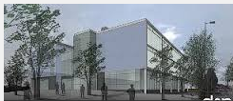
24/7 Learning of Mathematics at Featherstone High School Neil Bradford Deputy Head-teacher

Slide 2
Using Digital Technology to support the learning of Mathematics
On-line Maths Videos
Our Maths Web-site
On-line Maths lessons
i Maths books

Slide 3
On-line Videos
Started in 2011 using JING ( screen-capture)
Came across Jing through Russell Stannard teacher training videos
Jing (replaced by Screencast-O-Matic) Captures whatever you do on screen plus records your voice
Staff have Lenovo tablets with a pen allowing the user to write on word documents.
Converted Exam papers in PDFs to word
Started with a Colleague making 6 papers supporting the 2011 GCSE exam.
A*-C from 50%-65% Value Added ROL rank 5
3000 view recorded on our web-site the night before the exams

Slide 5
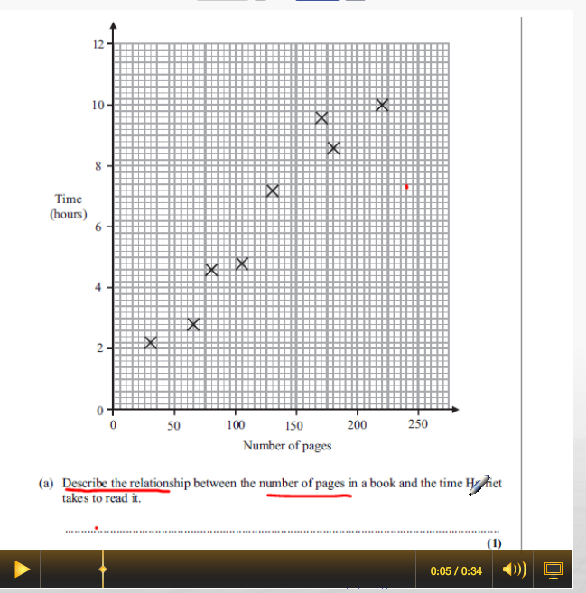

Slide 6
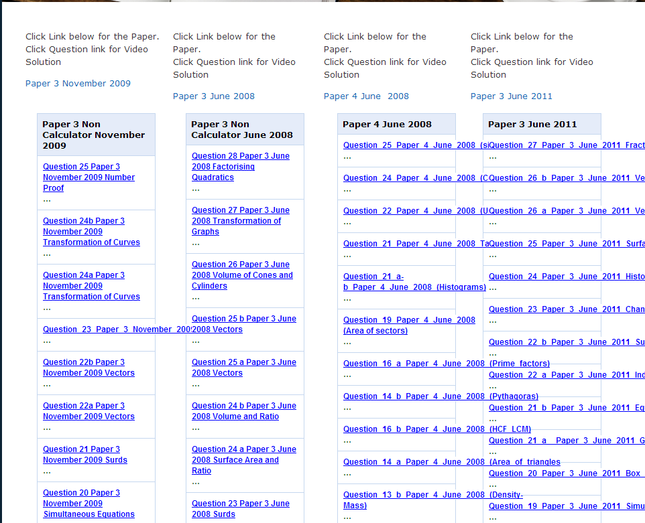
Organisation awkward!!

Slide 7
Jing to You tube
Jing quite time consuming to set up the exam paper questions
Time consuming to organise links
RSS feed good but not possible to edit
Not possible to show equipment within the video
Bought a web-cam and made videos hosted on you tube
Switched to the ipad for ease of use to make more videos
Uploaded to You tube organising exam papers into play lists
All links to papers and video on the web-site

Slide 8
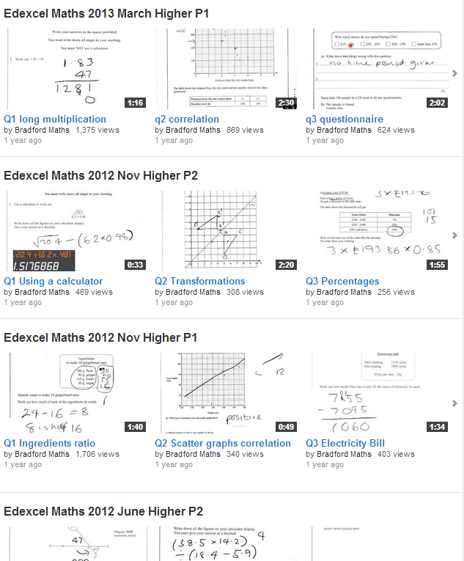
Playlists

Slide 9
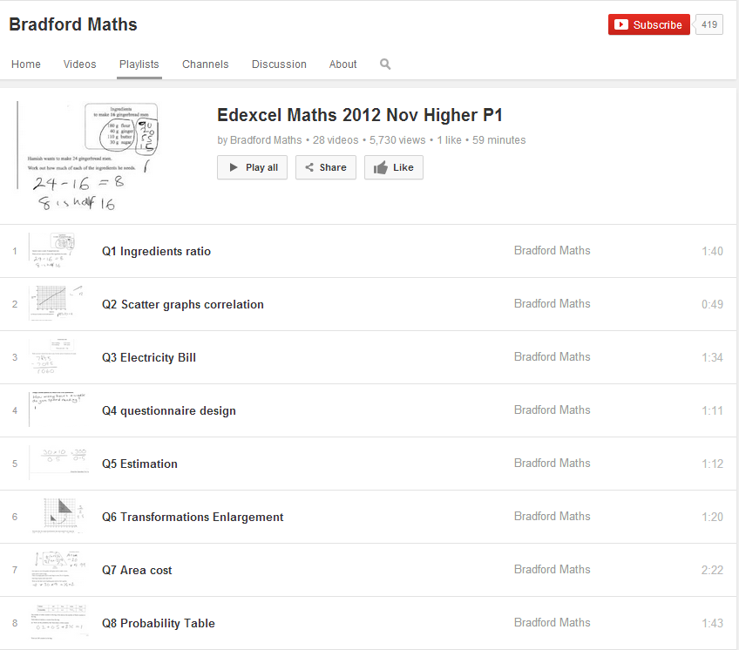
Play-list layout

Slide 10
Video-Production
Web-cam
Captures equipment
Upload to You tube on 1 click
Needs to be done in a room with the web-cam set up
Microphone has been an issue
Ipad
Screen shot questions
Very quick to produce
Cleaner look
1 click to you tube
Can be made any where
Easier to make more
Can’t capture equipment

Slide 11
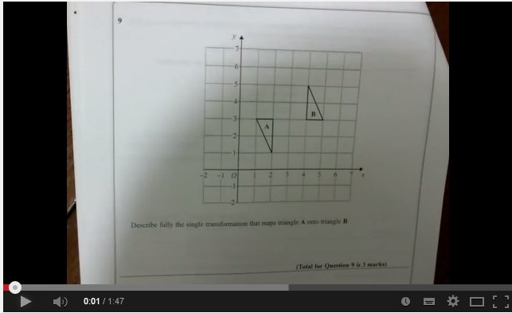
Example Video
WEB-CAM
IPAD

Slide 12
Moving to You tube
From 2012 all videos were hosted on you tube produced using a web-cam or ipad
Videos were made for all available exam papers
Added longer teaching videos covering most GCSE topics organised into playlists
Created web page topic links LINK

Slide 13
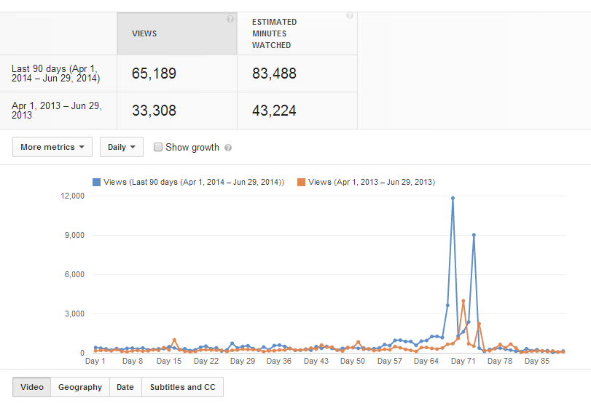
Usage Stats: last 90 days year on year

Slide 14
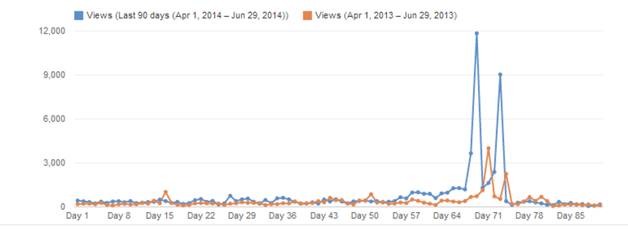
Usage stats: 213500
 | 2012 | 2013 | 2014
Year | 9477 | 70954 | 132542
Month | 5839 | 16381 | 39864
Day | 1168 | 3999 | 11843

Slide 15
Other Channels: links on the web site

Slide 16
Popular Channels
 | Subscribers | Views
Bradford Maths | 415 | 213 500
Maths Doctor | 4268 | 563 353
UK Maths Teacher | 5218 | 883 861
Hegarty Maths | 16 842 | 2 086 168
Exam solutions | 40 380 | 37 371 643
Patrick Jones | 323 230 | 96 651 724
Khan Academy | 2 070 024 | 452 572 844

Slide 17
Views per subscriber: an indicator of how much use each subscriber is making of the site
 | Subscribers | Views | Views per subscriber
Bradford Maths | 415 | 213 500 | 514
Maths Doctor | 4268 | 563 353 | 132
UK Maths Teacher | 5218 | 883 861 | 169
Hegarty Maths | 16 842 | 2 086 168 | 124
Exam solutions | 40 380 | 37 371 643 | 925
Patrick Jones | 323 230 | 96 651 724 | 299
Khan Academy | 2 070 024 | 452 572 844 | 218

Slide 18
Other uses
Flipped learning
Set up play-lists as desired
Playlists to support internal exams
Independent study
Student Videos

Slide 19
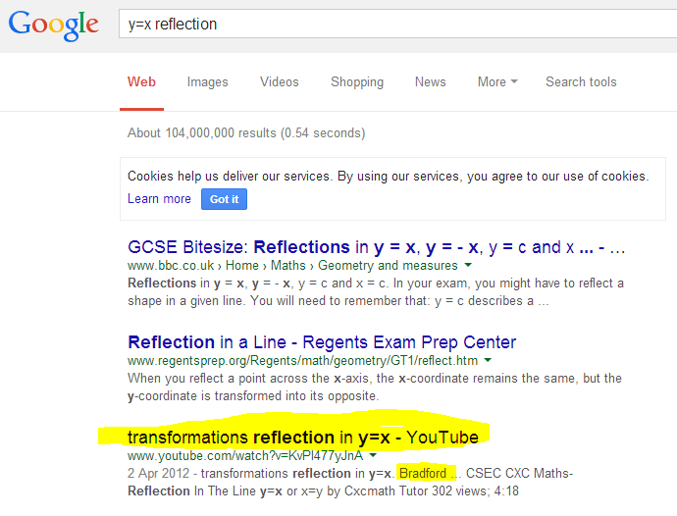
Most Viewed Video: Y=X reflection

Slide 20
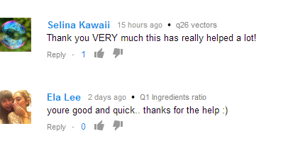
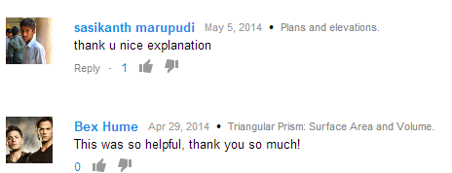
What the students say

Slide 21
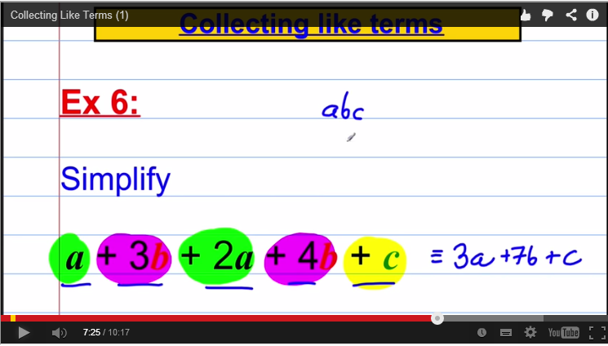
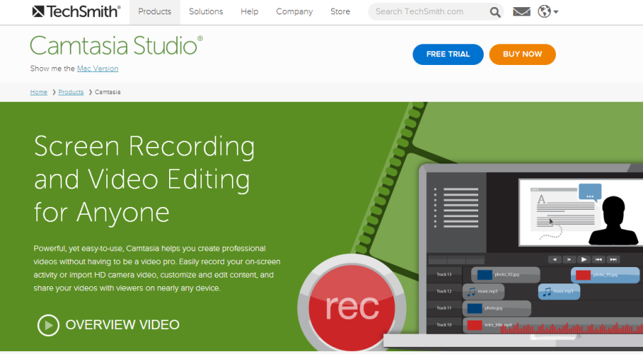
A more professional look…
Camtasia Studio with
graphics tablet and pen

Slide 22
Creating a Maths Web-site
Weebly

Slide 25
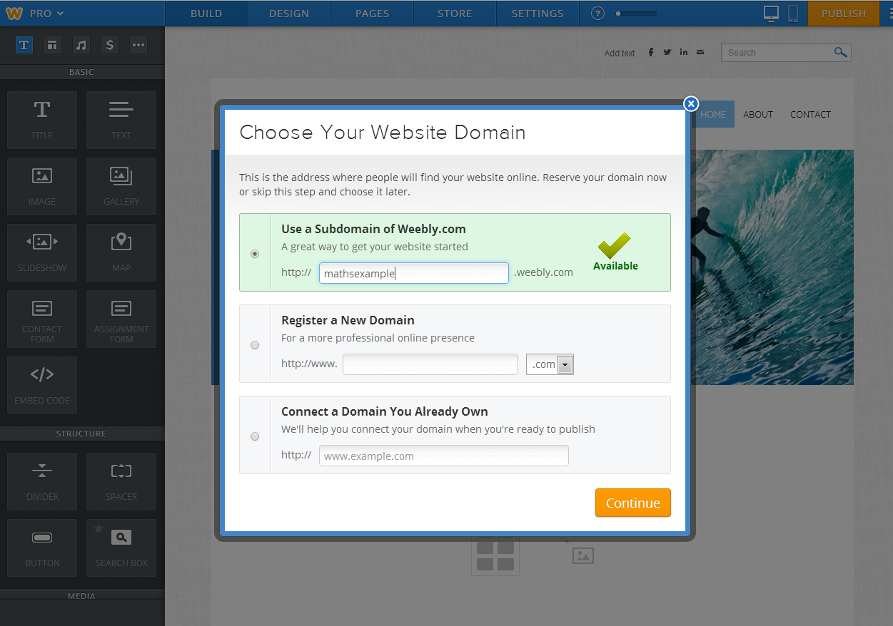

Slide 26
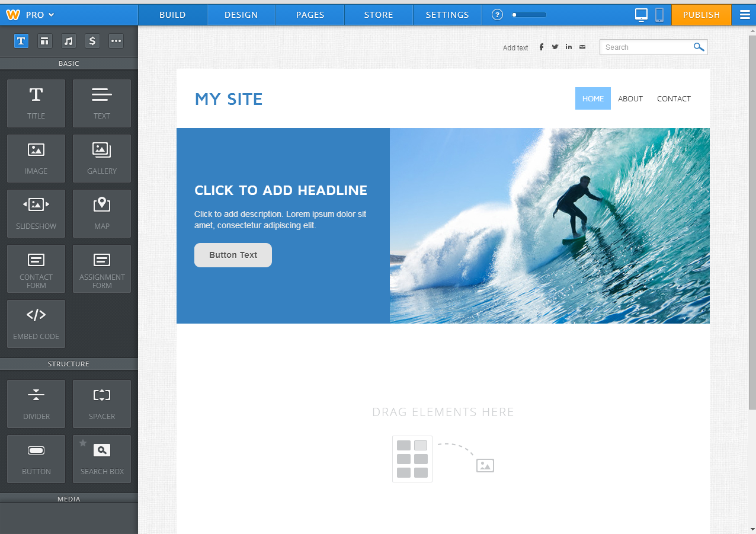

Slide 27
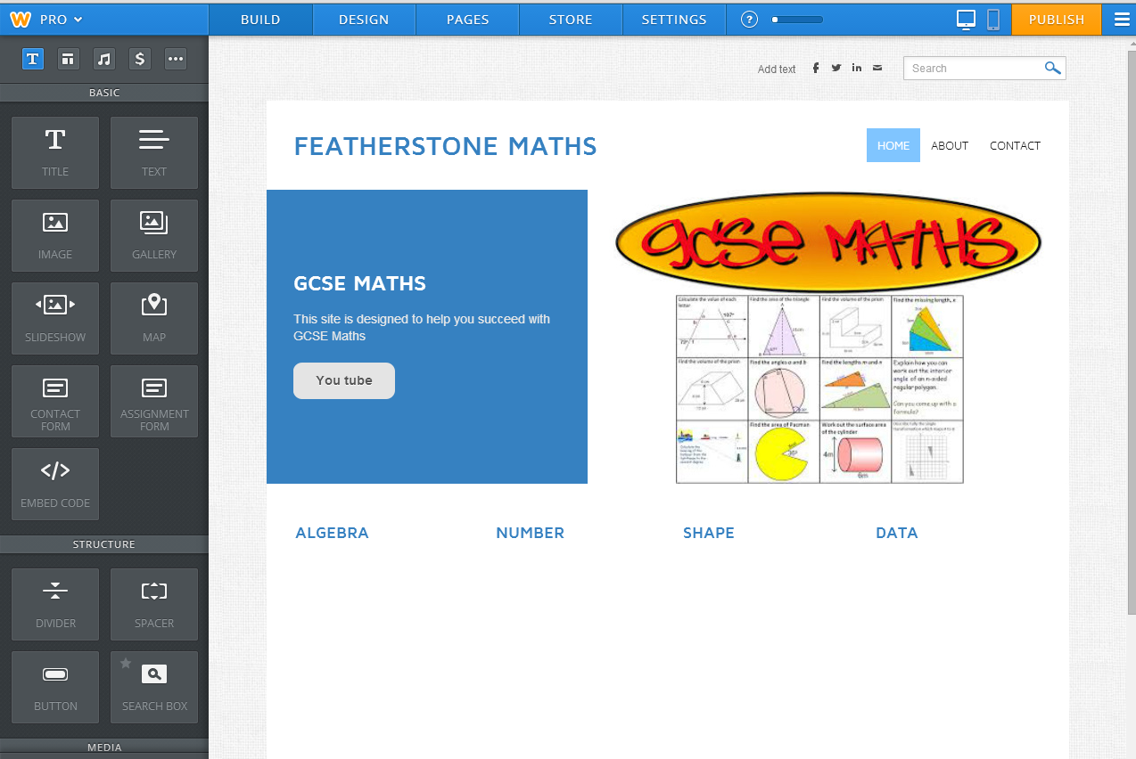

Slide 28
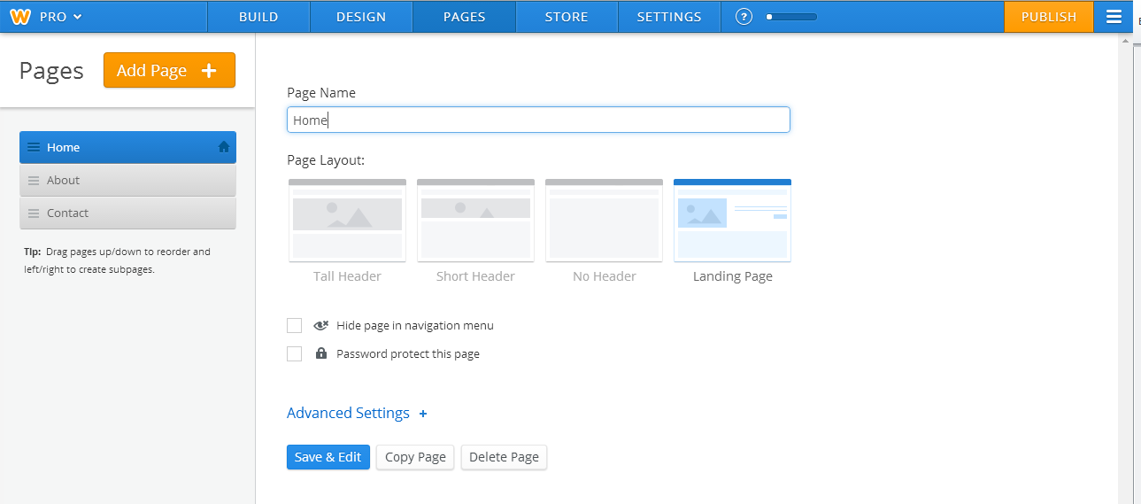

Slide 29
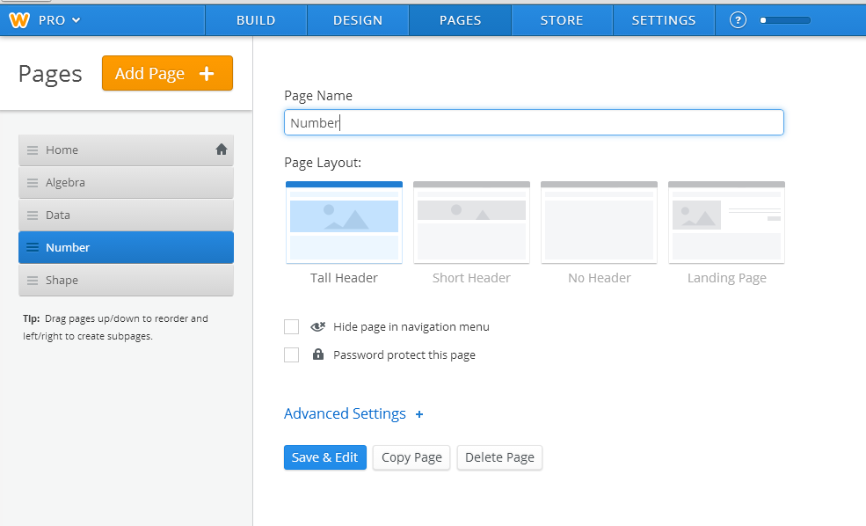

Slide 30
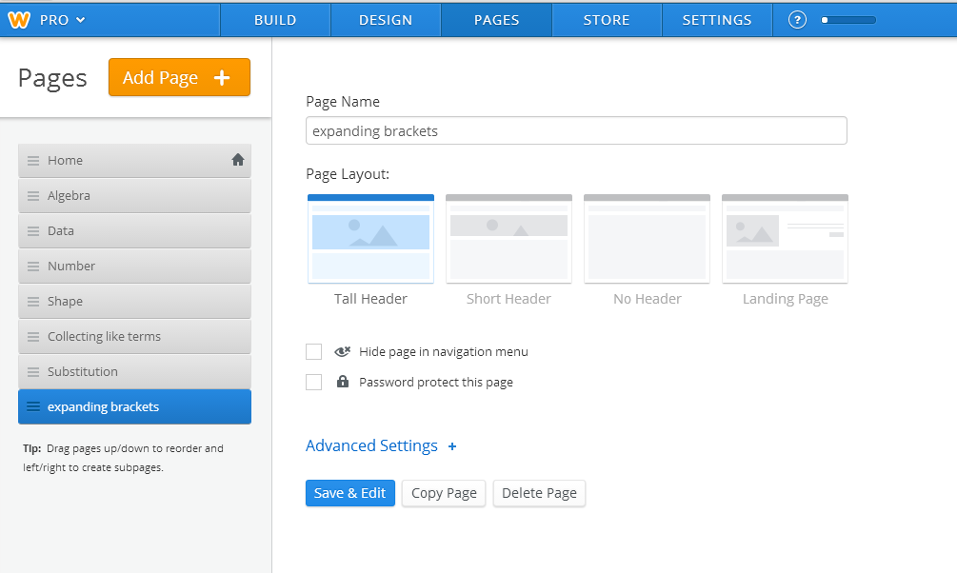

Slide 31
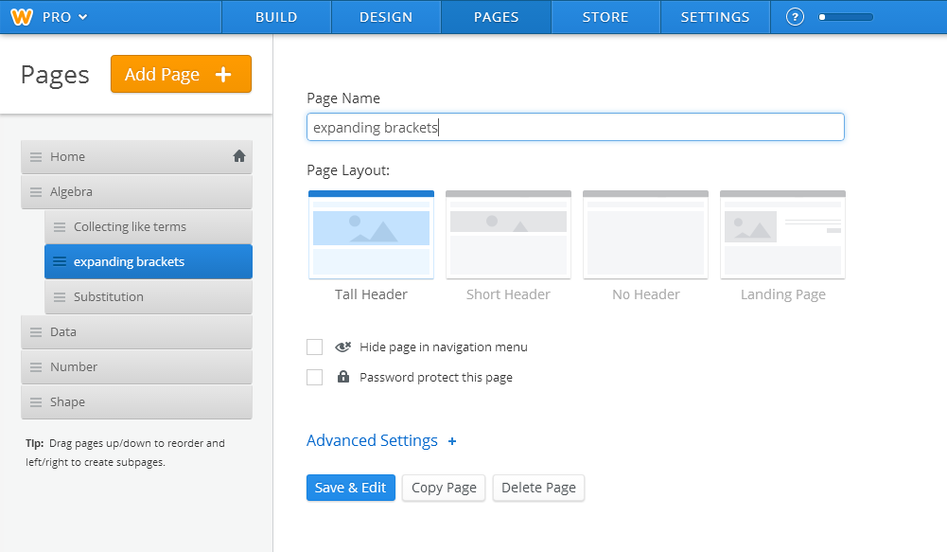

Slide 32
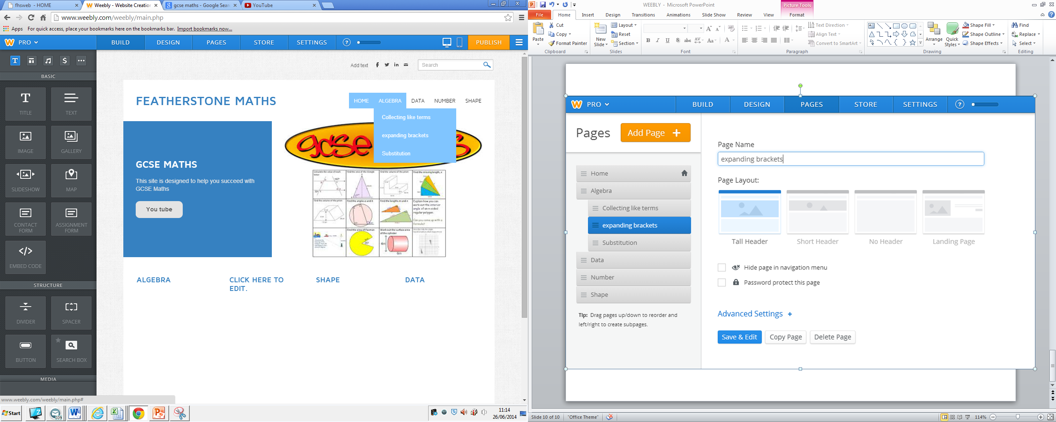

Slide 33
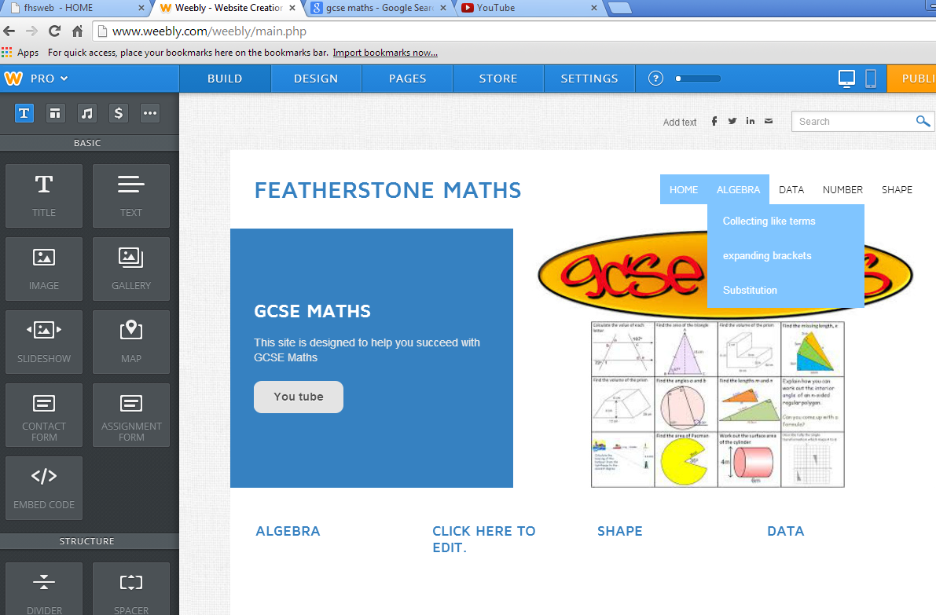

Slide 35
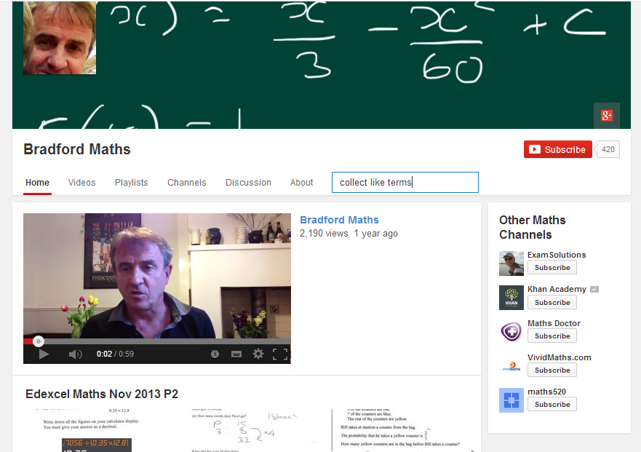

Slide 36
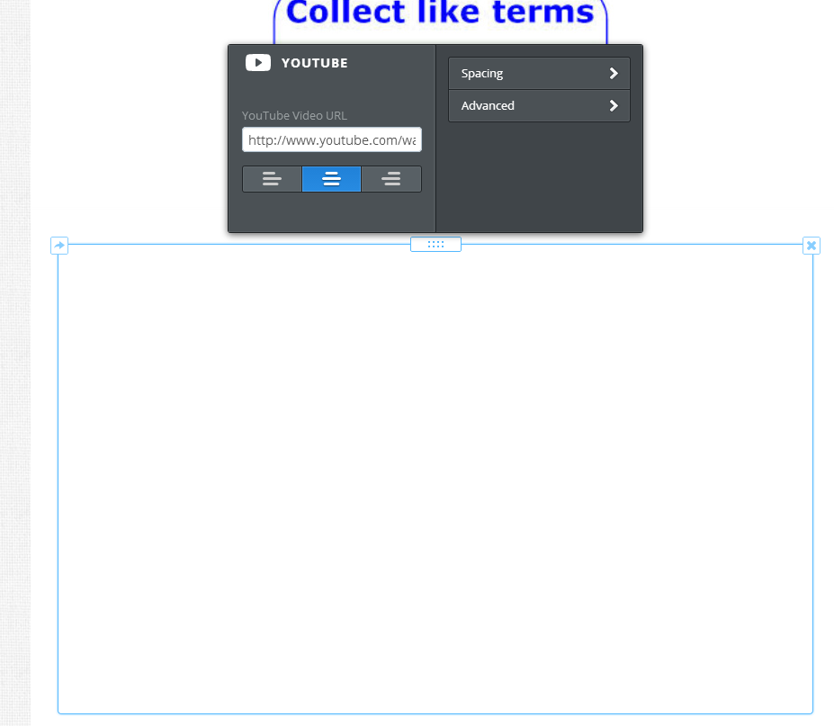

Slide 39
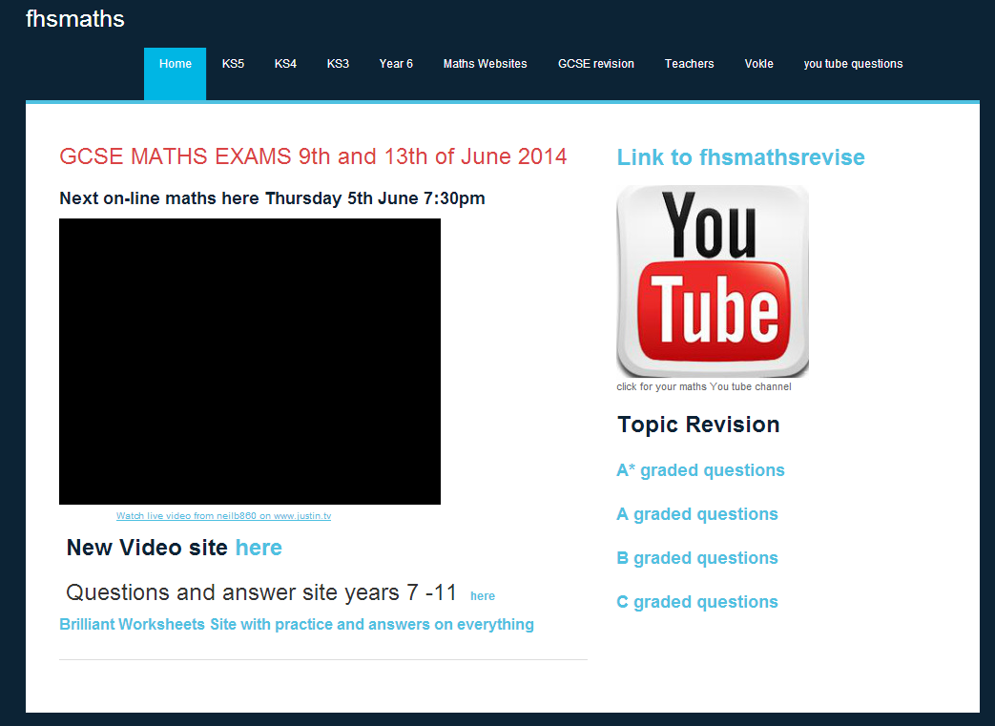

Slide 40
Constructing a page on Weebly
LINK

Slide 42
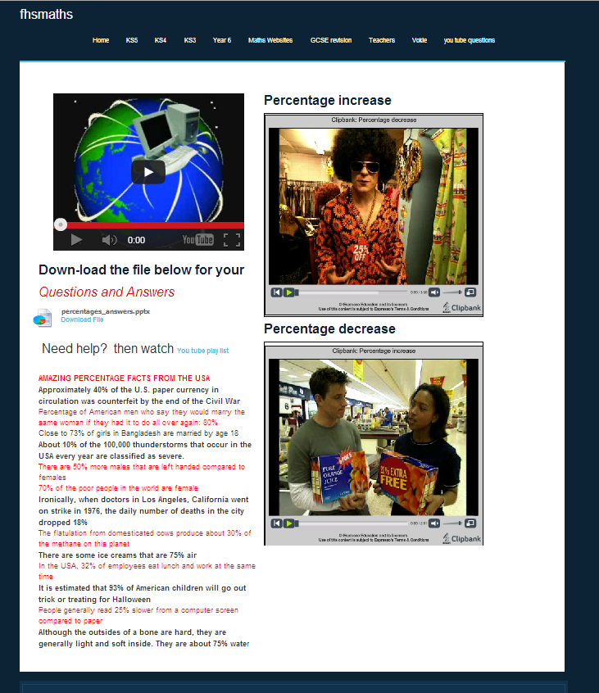

Slide 43
Web-site tour
LINK

Slide 44
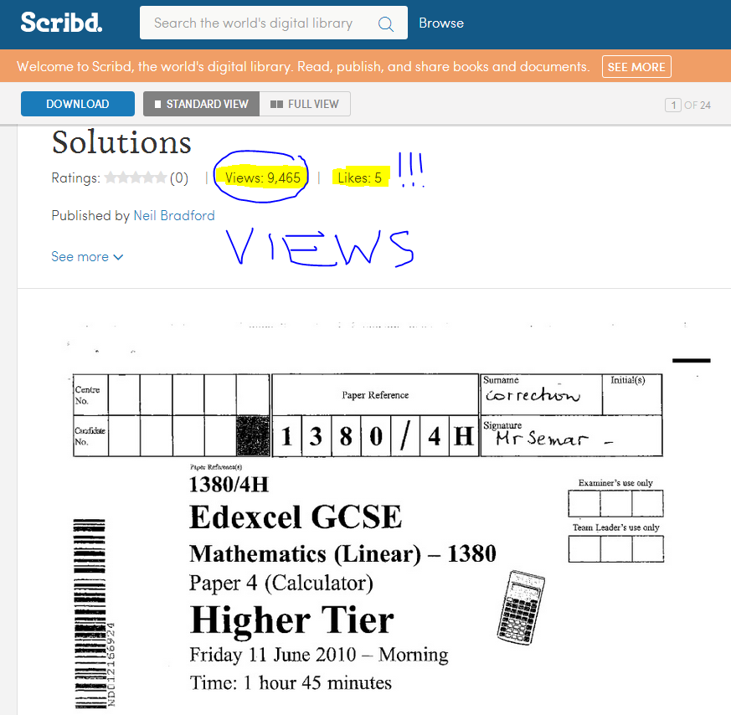
Early Usage statistics
Stats on unique page visits
500 page hits per hour before exams
Past Paper & Video pages hit the most
Reason for doing more!
Papers hosted on Scribd gave view hit

Slide 45
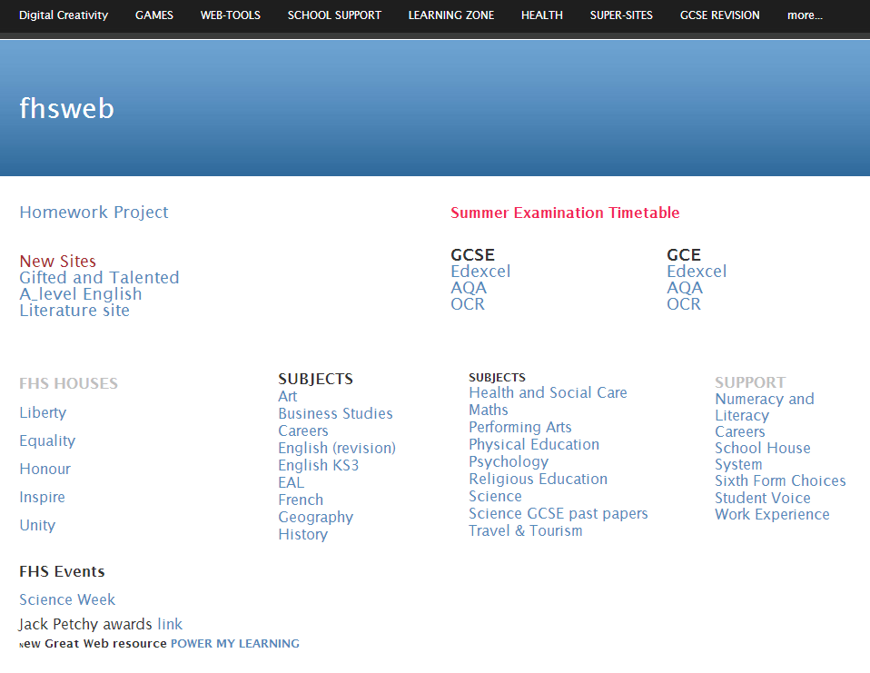
30 unique web-sites

Slide 46
On-line Maths

Slide 47
On-line Live Maths:
Started with Vokle
Found out about it through a twitter feed #edtech
Vokle is free software allowing broadcasting via a website ( one embed code)
Interaction with the audience is possible via a chat stream
Switched to Justin TV when I experienced technical difficulties
U stream I pad version
Vokle provides permanent recordings of the lessons

Slide 48
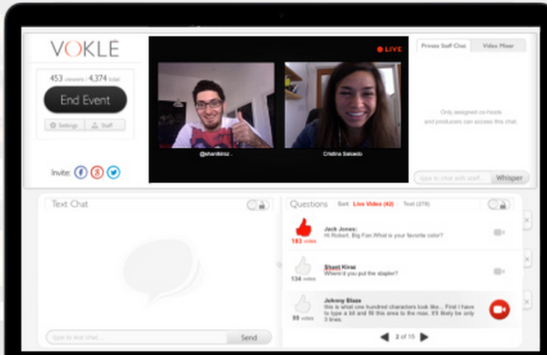
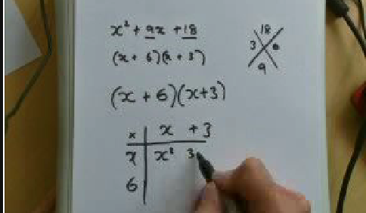
All student chat visible here
Students see this
Students enter chat here

Slide 49
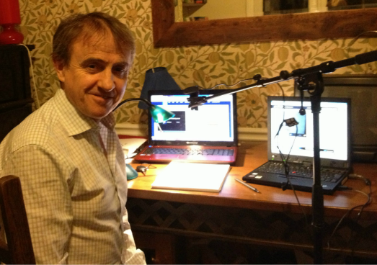
On line Live Maths: The Set Up
Lap tops to broadcast and view
Web cam attached to adjustable microphone stand
Sign up ( once) and sign in
Place embed code onto web page ( only needs to be done once)
Click broadcast and connect webcam and microphone
Pre-prepared questions to put to students
Ipad to demo use of a calculator
LINK

Slide 50
Broadcasts / Participants
10 x1-1.5 hours S1 lessons to my class which all attended voluntarily
5 x2hr lessons preceding November March and June 2012/2013 (50-70 students)
2 x 2.5 hrs. exam revision for year 10 ( 112 students)

Slide 51
Pros and Cons
Student concentration
Amount of work covered
Fun different way of engaging students
Competitive edge
Can see which questions students struggle with
Students can be given time-out or ban if necessary
Lesson automatically recorded
Very popular
Can’t monitor individual student progress well
Students can enter inappropriate comments
Can’t check whether they are wearing their uniform
(Occasional) Technical issues

Slide 52
Student Comments

Slide 53
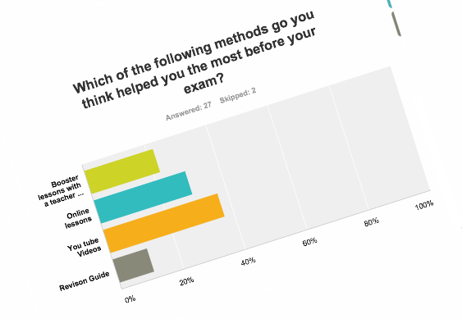

Slide 54
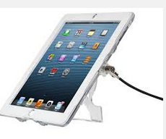
i books

Slide 55
I books
Created with an app called Book creator
Book can contain text sound and Video
Costs £2.49!!
E-Book can be uploaded to and downloaded from file storage sites such as Evernote & Dropbox
Students can download books to apple devices
Once downloaded no internet required

Slide 56
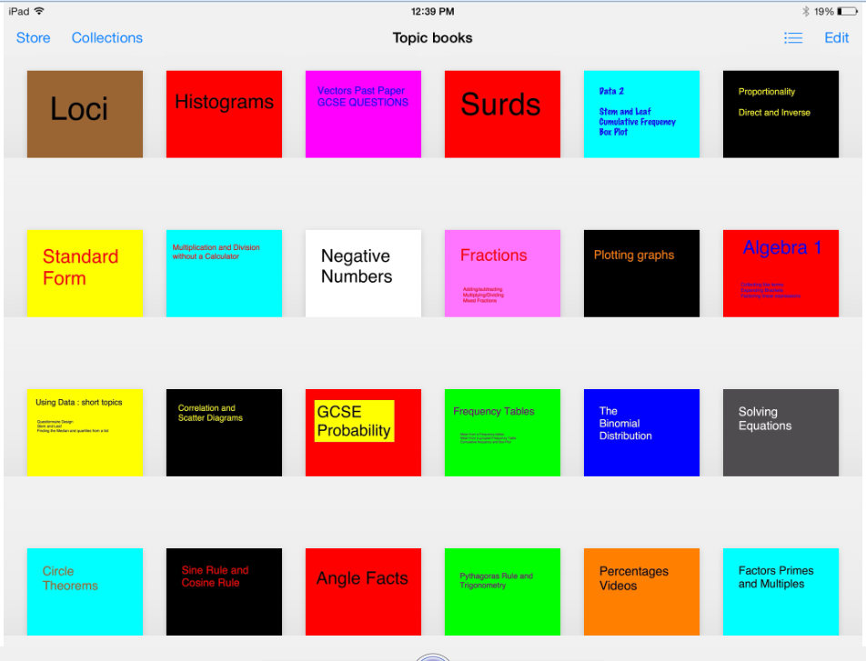

Slide 57
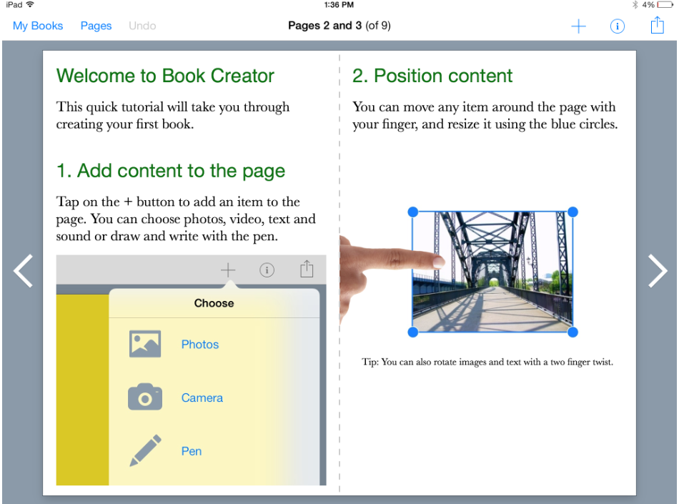

Slide 58
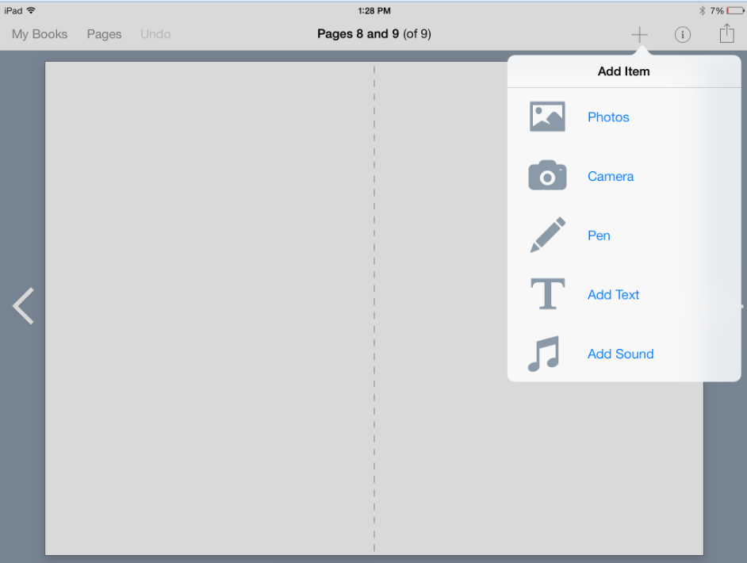

Slide 63
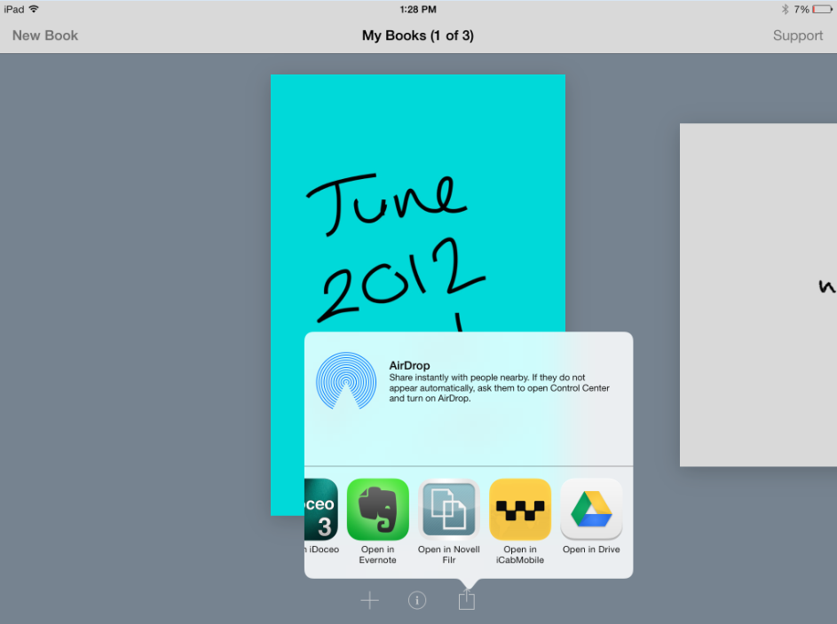

Slide 64
ibooks
Book creator
Sound and or Videos can be embedded
You tube videos can be transferred to your camera roll using an app called icab mobile
Books uploaded to and shared via file storage
Evernote Dropbox

Slide 66
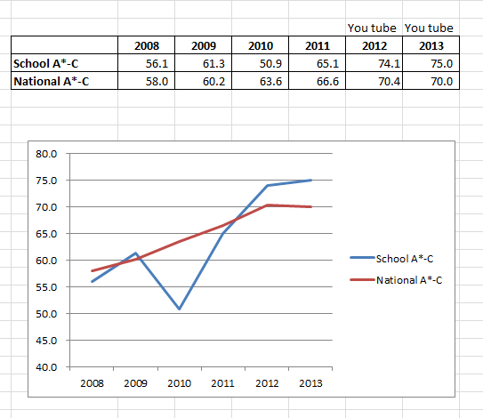
Impact A*-C

Slide 67
Impact : expected progress
 | 2011 FHS | 2011 NAT | 2012 FHS | 2012 NAT | 2013 FHS | 2013 Nat
Low | 71 | 39 | 70 | 44 | 83 | 44
Middle | 84 | 68 | 88 | 74 | 88 | 77
High | 81 | 79 | 86 | 79 | 89 | 81
All | 78 | 64 | 84 | 68 | 86 | 70

Slide 68
Lower ability students on average are 1.25 grades ahead of expectation
 | FHS Maths VA | National MATHS VA | Diff
All | 1003.4 | 1000 | 3.4
Boys | 1004.2 | 999.7 | 4.5
Girls | 1002.9 | 1000.2 | 2.7
High | 1000.5 | 1000.2 | 0.5
Middle | 1003.2 | 999.9 | 3.3
Low | 1007.1 | 999.5 | 7.6

Slide 70
All resources available at

